Slide 1
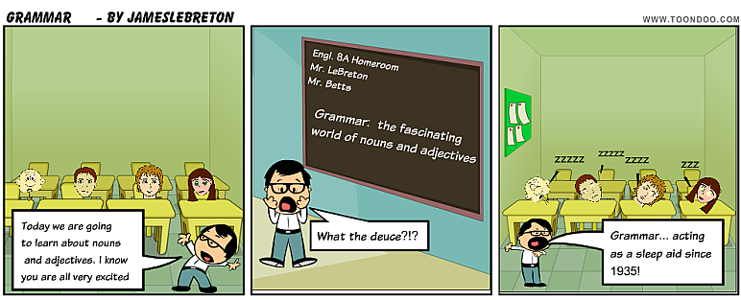
Nouns and adjectives
JL
James LeBreton Jason Betts
www.toondoo.com - check it out

Slide 2




What is a Noun?
JL
A noun is a word used to name a person, a thing, a animal, a place, or an idea.
Animal
Idea
Person
Place

Slide 3
What you need to know:
JL
Nouns change form to distinguish between singular (one) and plural (more than one). Most nouns add -s or –es for the plural.
Ex. earthquake → earthquakes & city → cities
Some nouns have irregular plurals.
Ex. woman → women & child → children

Slide 4
What you need to know:
JB
Most nouns also form the possessive to indicate ownership. Singular nouns usually add an apostrophe plus –s (Tara’s poem); plural nouns usually add just an apostrophe (citizens’ rights)
Noun Gender – are quite rare today but may still exist to refer to occupational categories.
Ex. Common examples: actor/actress & waiter/waitress

Slide 5
What is an Adjective?
JL
Adjectives describe or modify nouns and pronouns. They specify which one, what quality, or how many.
Ex. old city → specifying the quality.
two pears → specifying how many.

Slide 6
What you need to know:
JB
Adjectives appear in three forms: the positive, the comparative, and the superlative.
Example:
The positive form is the basic form:
→ good, angry
The comparative form indicates a greater degree of quality:
→ better, angrier
The superlative form indicates the greatest degree of quality:
→ best, angriest

Slide 7
Work Citied
JL
The Little Brown Handbook – 5th Canadian ed.
www.toondoo.com – create your own comic.

